Slide 1

INTELLERA: A Hardware Based Accelerated Matrix MAC Processor
Team Members:
2020414 Saad Khan
2020487 Syed Zaeem Shakir
2020217 Mahnoor Maleeka
Supervisor: Dr Fahad Bin Muslim
Co-supervisor: Dr Waqar
Faculty of Computer Sciences and Engineering Ghulam Ishaq Khan Institute of Engineering Sciences and Technology, Pakistan
Notes:
1

Slide 2
Evaluation Criteria
PLO 3 | Design/Development of Solutions
PLO 5 | Modern Tool Usage
PLO10 | Communication
PLO11 | Project Management
Rubrics | PLO3 | PLO5 | PLO10 | PLO11 | Marks
Poster Design |  |  | ✓ |  | 5
Requirements mapped to the prototype | ✓ |  |  |  | 10
Solution development using modern IT tools/techniques |  | ✓ |  |  | 10
Progress Tracking according to promised deliverables |  |  |  | ✓ | 5

Slide 3
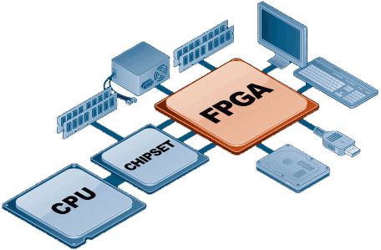
Recap
Problem Statement:
RISC-V Processor on FPGA
Power-Efficient Hardware Design
Matrix MAC Operations
Significance:
Innovation
High-Performance Computing
Benefits:
Speed
Efficiency
Breakthroughs

Slide 4

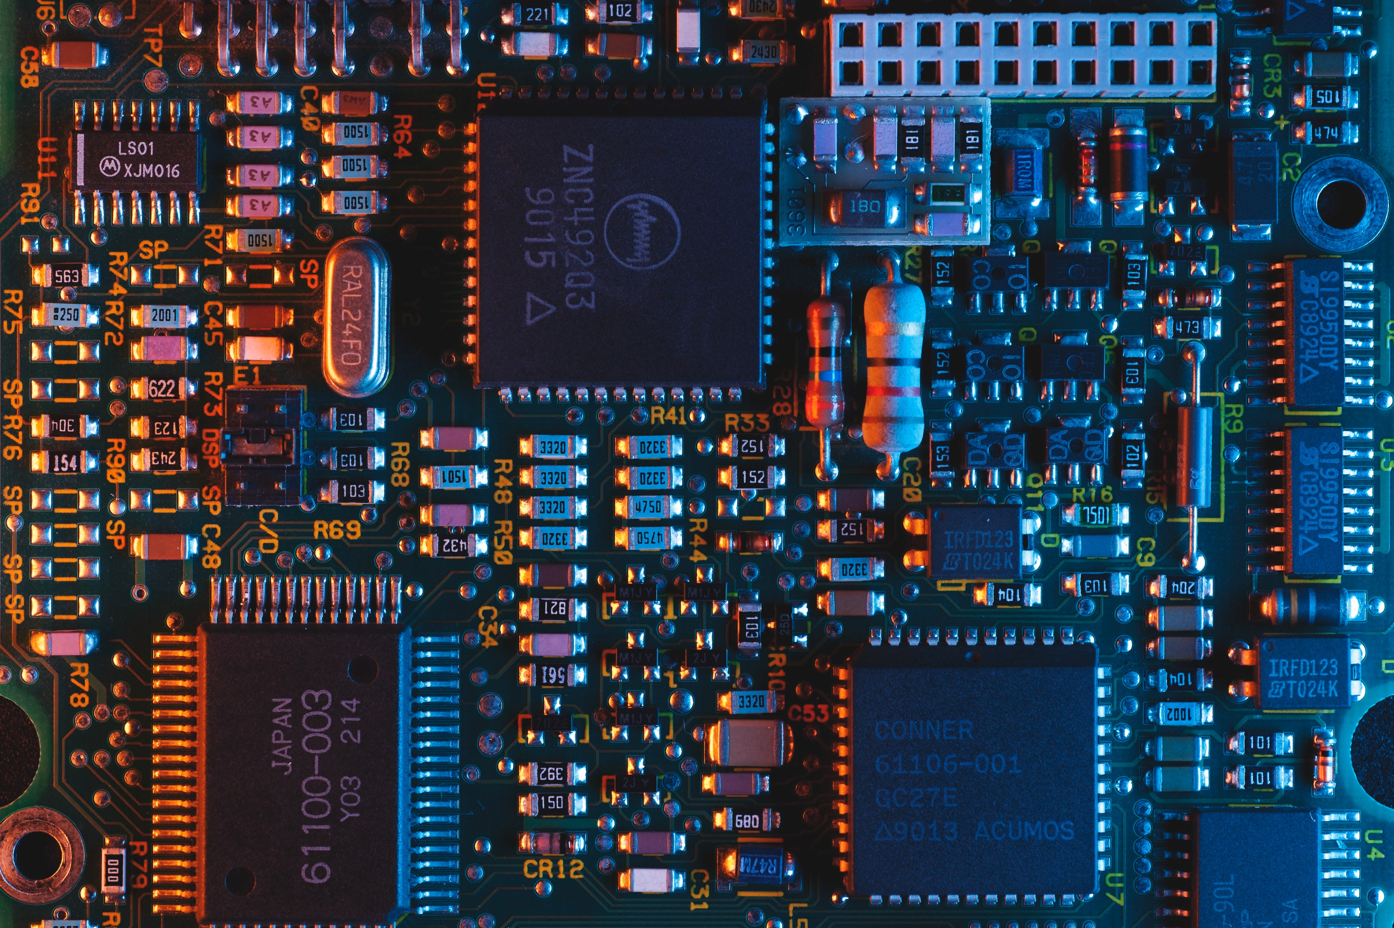
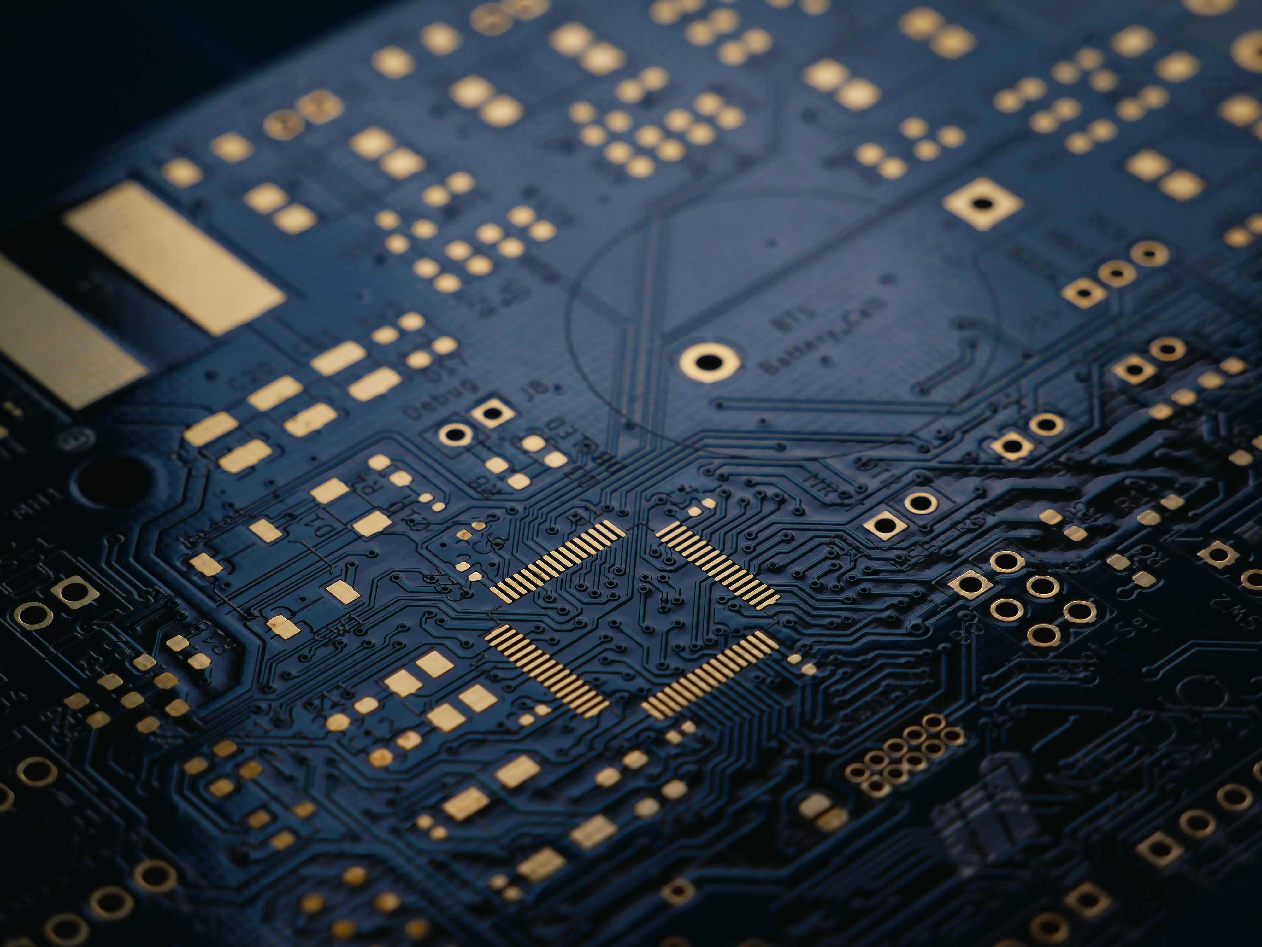
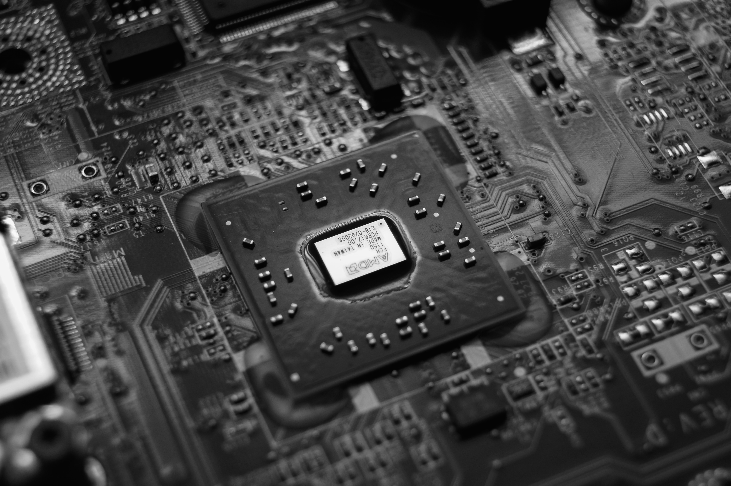
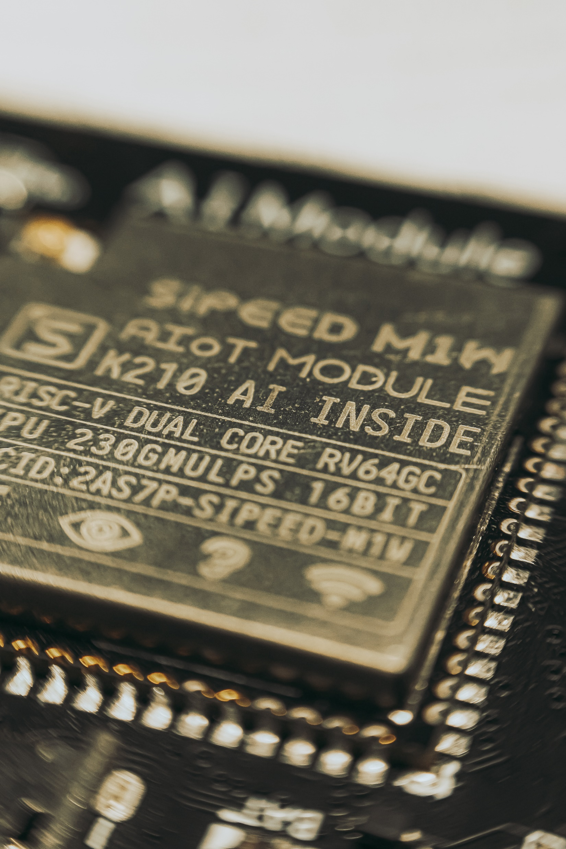
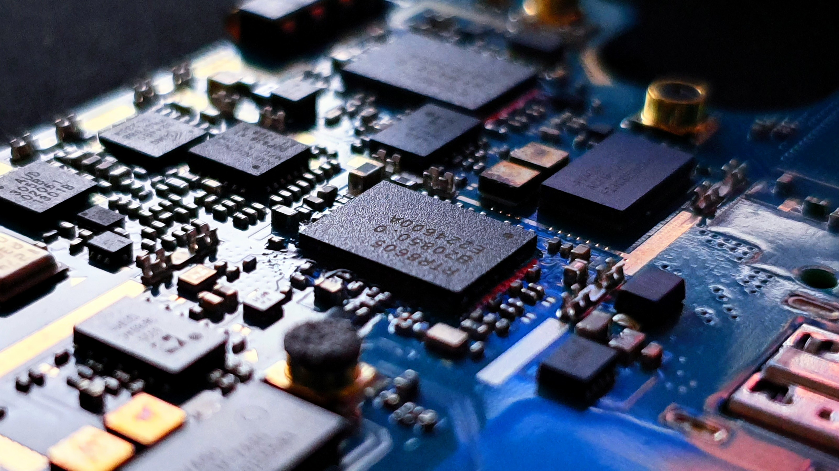
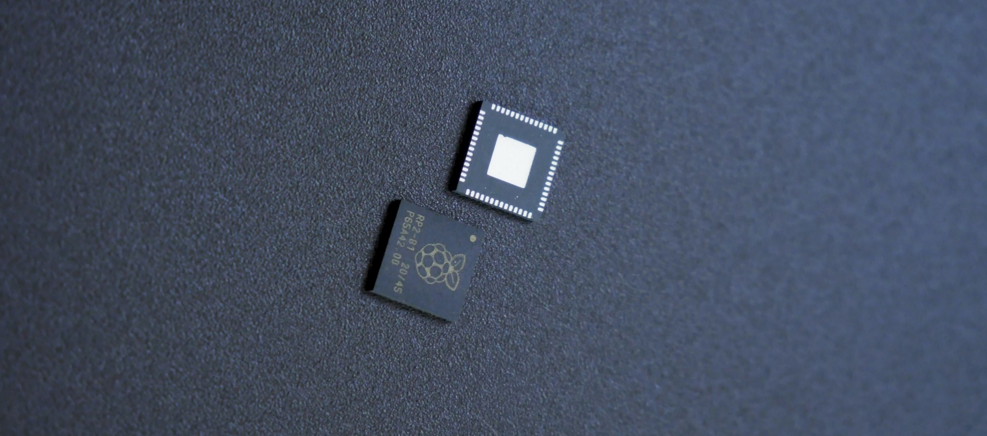
INTELLERA

Slide 5





Rubric 4: Progress Tracking
Project Management Tools:
INTELLERA

Slide 6
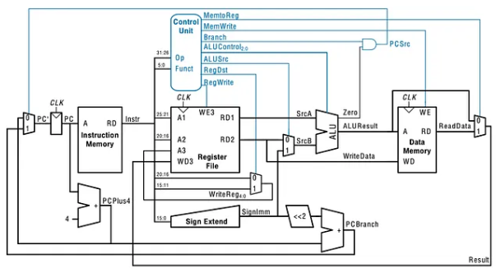
Rubric 2: Requirements mapping
Single Cycle Processor
Sep 2023 – Oct 2023
Features:
Low Power Consumption
Low Hardware Complexity
Single-Clock Instruction Execution
Predictable Timing
20+ executable Instructions
INTELLERA

Slide 7
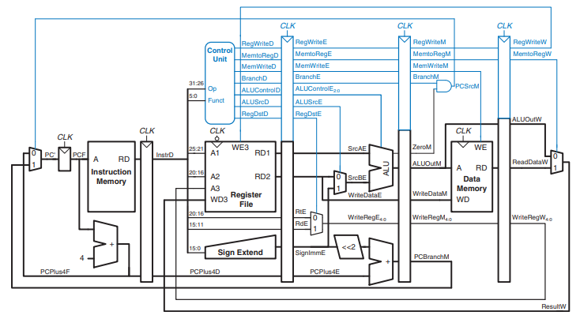
Rubric 2: Requirements mapping
5 Stage Pipelined Processor
Oct 2023 – Nov 2023
Features:
5 stage Pipelining
Increased Throughput
Efficient Resource Utilization
More Control
INTELLERA

Slide 8
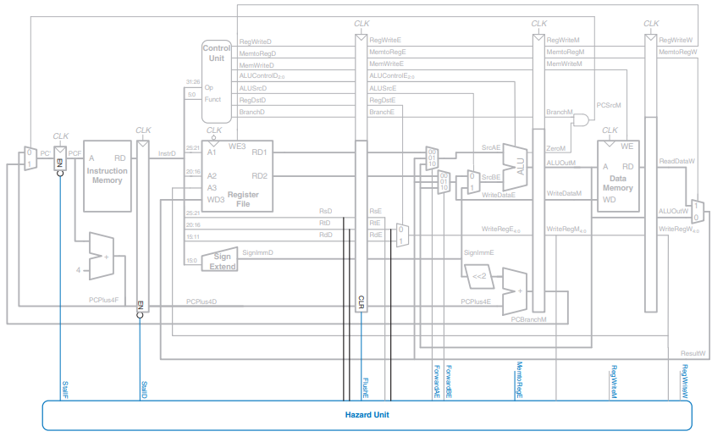
Rubric 2: Requirements mapping
5 Stage Pipelined Processor
With Hazard Control Unit
Nov 2023 – Dec 2023
Features:
Complete Hazard Control Unit
No Data Hazard
No Structure Hazard
No Branching Hazard
Only 1 Cycle for Flush
INTELLERA

Slide 9
Rubric 2: Requirements mapping
5 Stage Pipelined Processor
With Matrix MAC
MATRIX MAC
MAC_BUS
MACSrcD
MACSrcE
MACSrcM
Features:
Complete Matrix Mac Unit
Additional 6 Instructions for MAC
Separate Flash Memory
Parallel Data read/Write
Pipelining Support
INTELLERA
MACDME_D
MACDME_E
MACDME_M
MACA1_D
MACA1_M
MACA2_D
MACA2_M

Slide 10
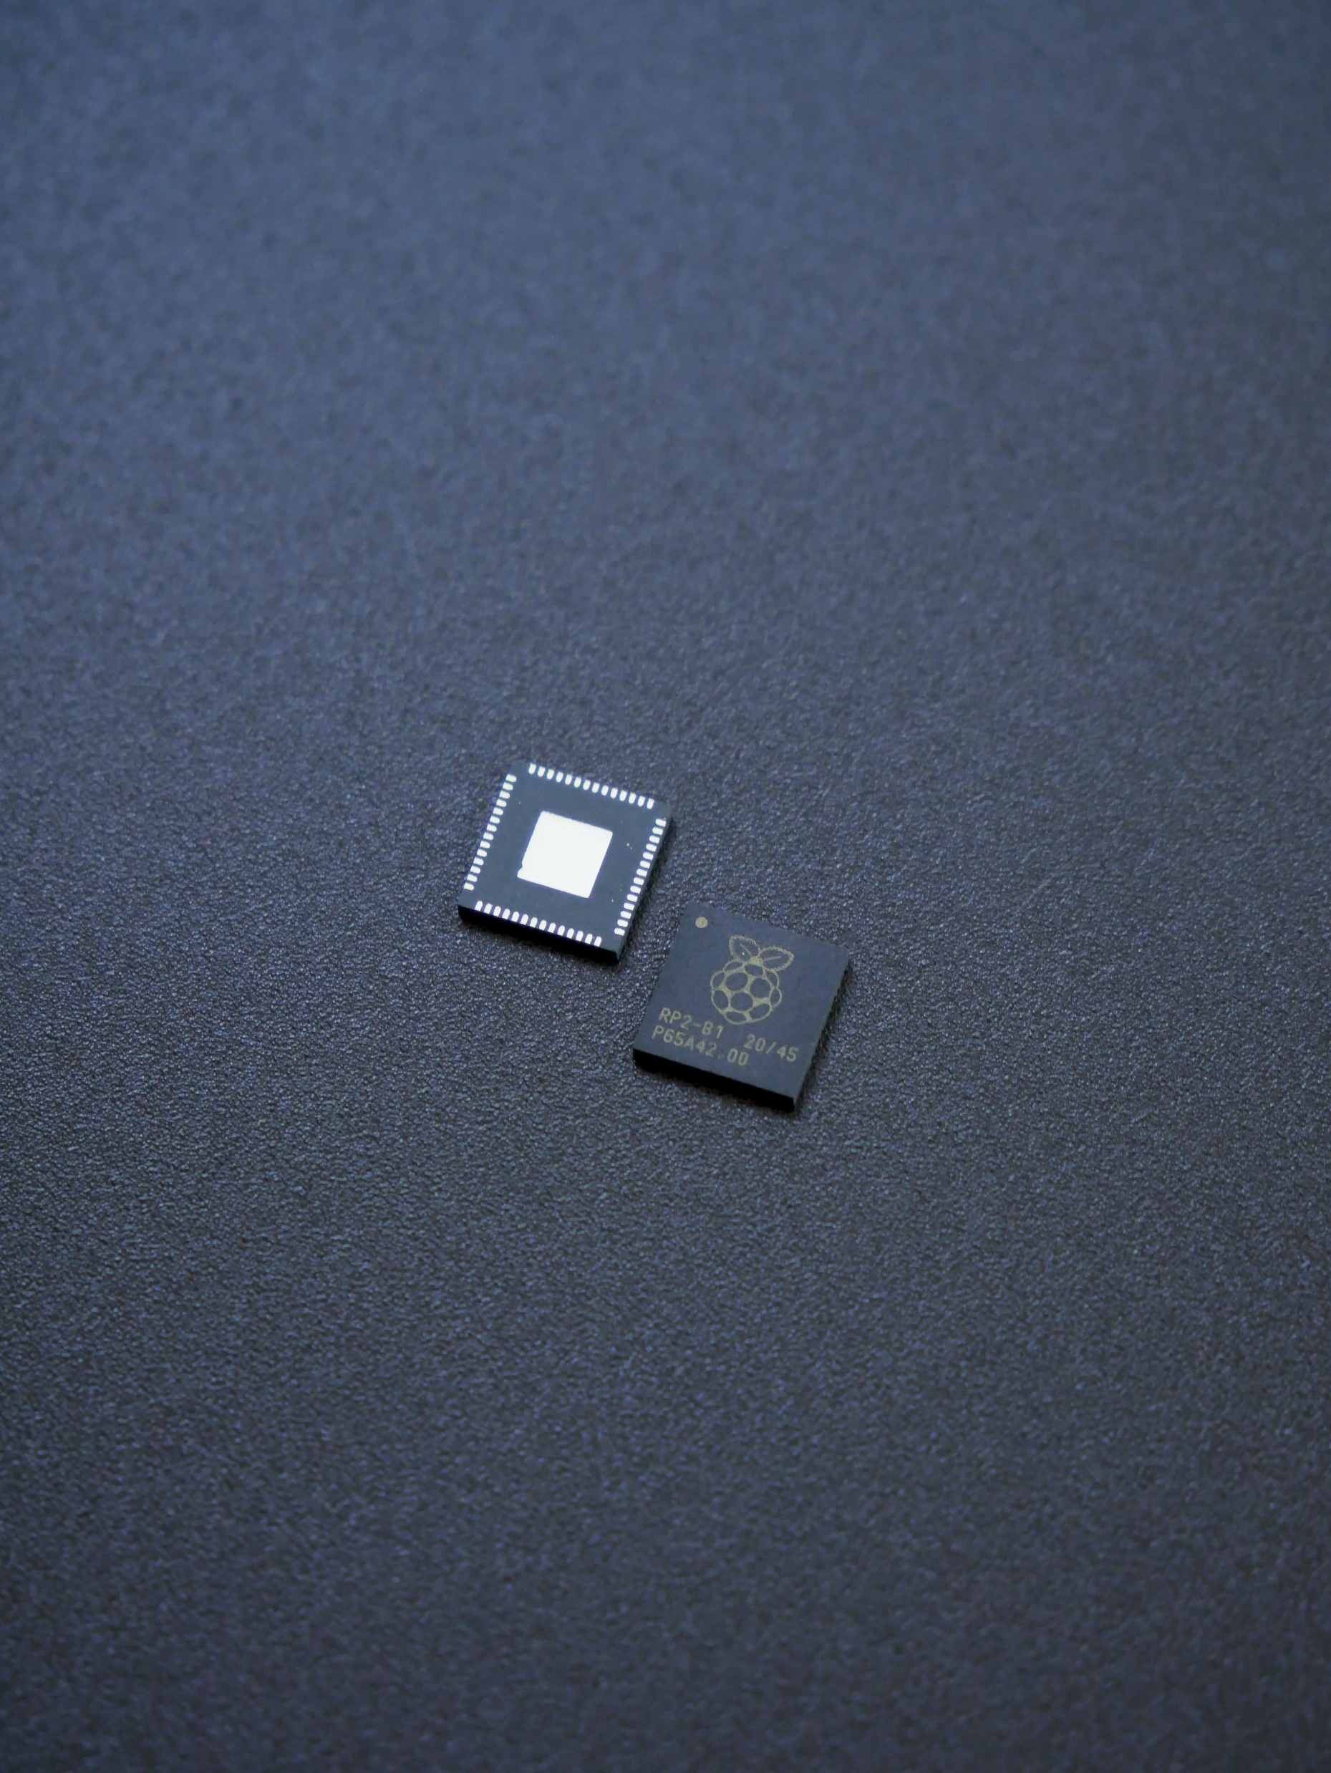
Rubric 2: Requirements mapped to the prototype
Feature Matrix, FR
Requirements | Previous Status
Custom ISA | Completed
Compatibility | Completed
Pipelining | Ongoing
Control Hazard | Not Started
FPGA Implementations | Not Started
Matrix MAC Instructions | Not Started
Testing & Verification | Ongoing
Current Status
75%
Improved
INTELLERA
Completed
Completed
Completed
Completed
Ongoing
Ongoing

Slide 11
Rubric 2: Requirements mapped to the prototype
FPGA Analysis
Parameters | Single Cycle Processor | 5 stage Pipelining with Control Unit | Processor with Matric MAC
Lookup Tables | 0.22% (89) | 0.45% (283) | N/A
Flip Flops | 0.01% (8) | 0.18% (223) | N/A
LUTRAM | 0.36% (48) | 0.36% (48) | N/A
DSP | 0% (0) | 1.25% (3) | N/A
Frequency | 322 MHz | 322 MHz | N/A
Power | 0.165 W | 0.132 W | N/A
INTELLERA
Board: NEXUS 4 DDR

Slide 12




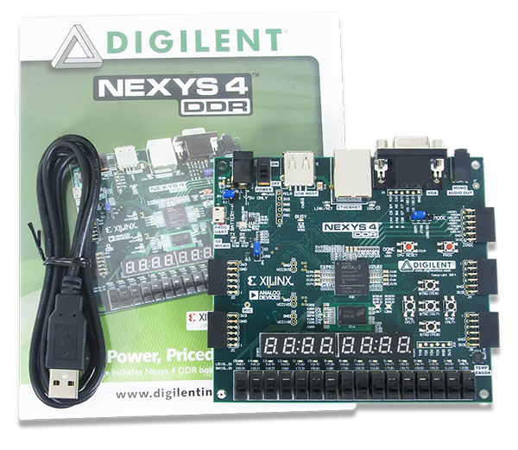

Rubric 3: Solution development using modern IT tools/techniques
Technologies Used
Sep 2023 – Oct 2023
INTELLERA

Slide 13
Rubric 1: Poster Design & Demo
Poster
Demo
INTELLERA

Slide 14
Rubric 1: Poster Design & Demo

Slide 15
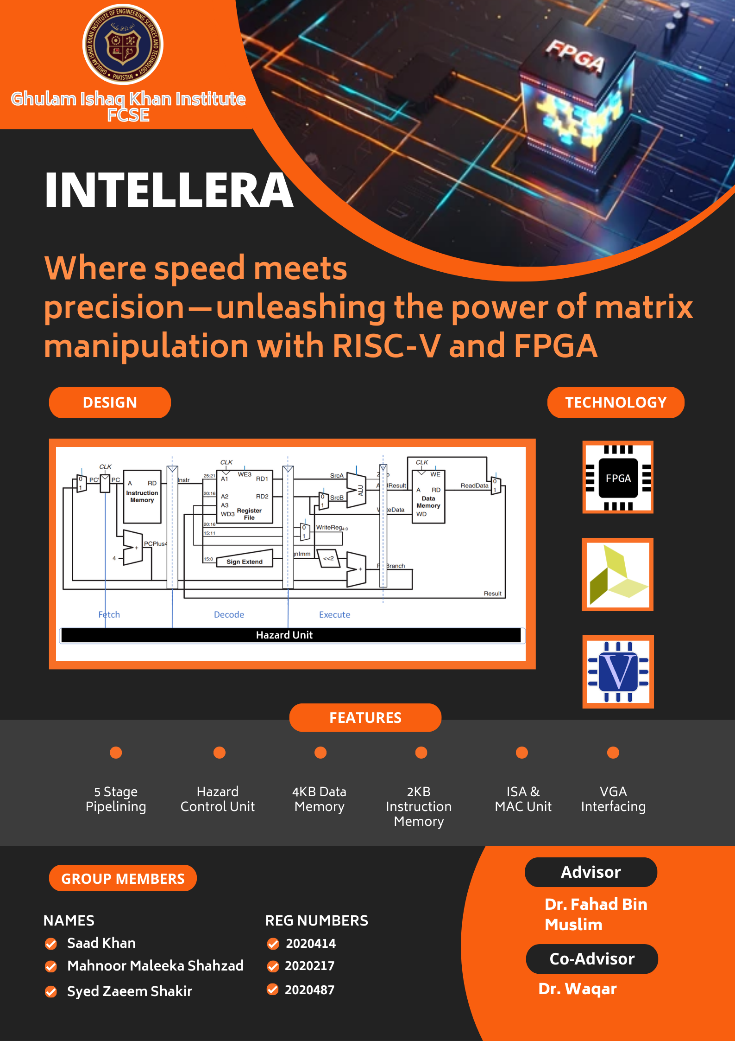
Rubric 1: Poster Design & Demo

